Slide 1
Complete Streets:
Finding Space for Freight

Slide 2
Externalities on urban streets
Dangerous collisions
Traffic congestion
Lane obstructions
Infrastructure damage
Pollution
Air
Noise

Slide 3
What are the elements of a livable city?
Which of these elements can function without goods movement?

Slide 4
*
* If this tree is native and exists in a hospitable environment.

Slide 5
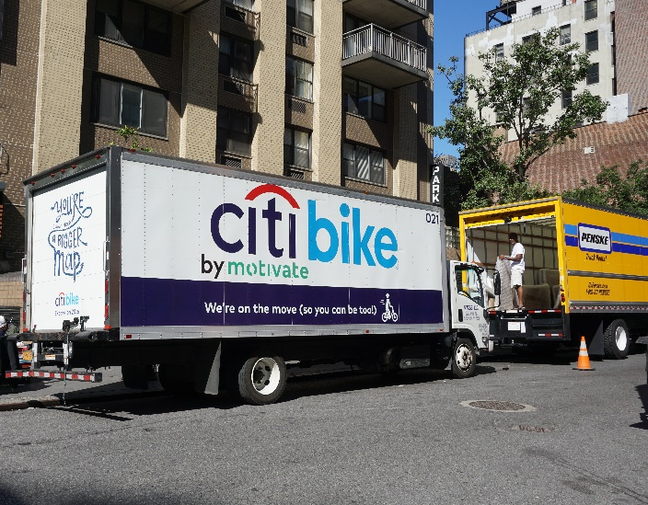
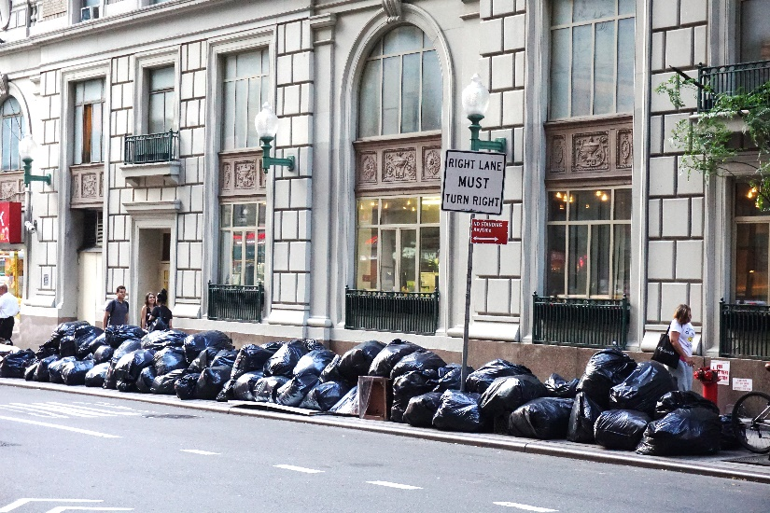
Goods movement is critical to social and economic welfare

Slide 6
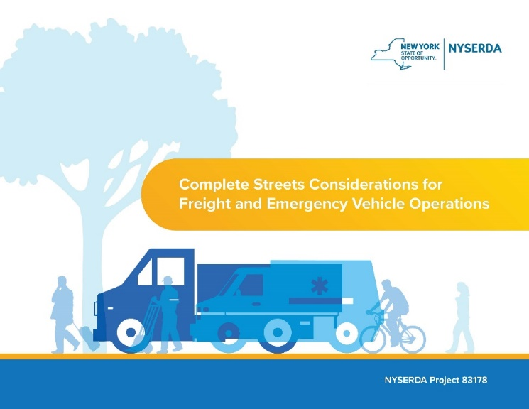
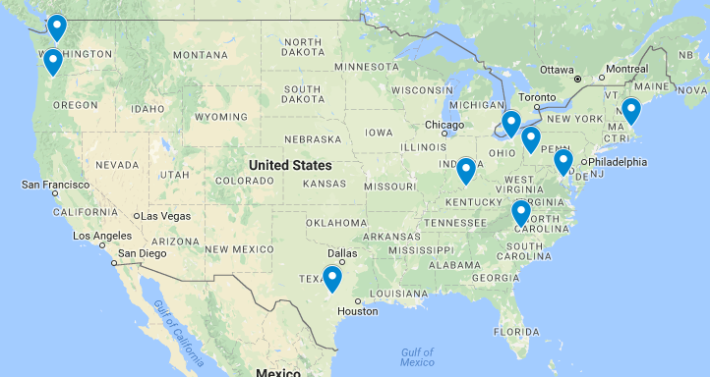
Outline
7 Common Challenges and Solution Approaches
Demand Management
Urban Freight and COVID

Slide 7
Potential Areas of Guidebook Application
Urban centers
Suburban/exurban areas with warehousing/industrial development
Suburban/small town main streets
Industrial/commercial campuses

Slide 8
7 Common Challenges
Selecting an appropriate design vehicle
Vehicle navigation challenges
Providing adequate space for large vehicle turns
Reducing conflicts with vulnerable roadway users
Safely reducing speeds
Providing network connectivity and redundancy
Curbside challenges
Providing adequate space for parking, loading, and emergency response operations
Providing curb and building access

Slide 9
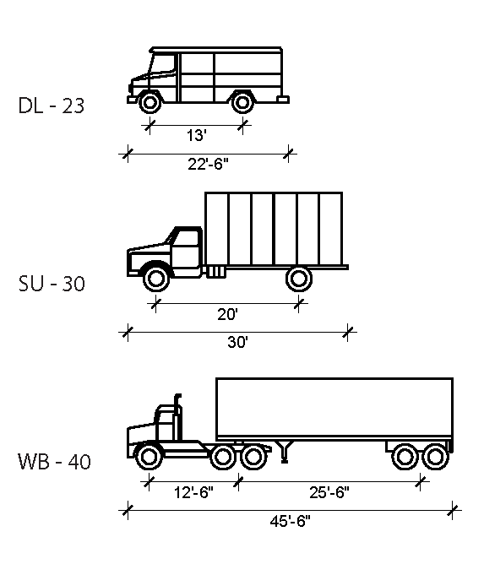
Freight Design/ Control Vehicle Selection
Current/expected freight traffic flows
Freight trip generating land uses
Street functional classes and network designations
Applicable truck size and weight regulations
Historic incident data involving freight vehicles

Slide 10
Freight Industry Engagement
Internal agency freight experts
Agency advisory boards
Local freight quality partnerships
Freight industry associations
Business improvement district/association of local business owners
Local businesses, building managers, or carriers operating in a project area

Slide 11
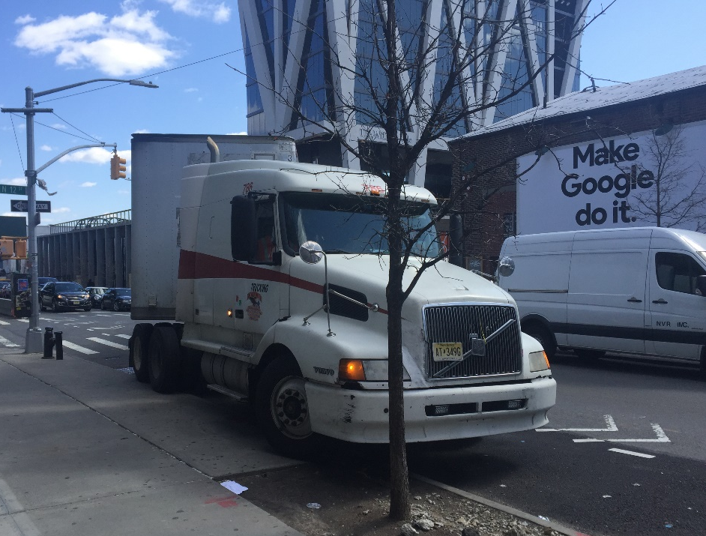
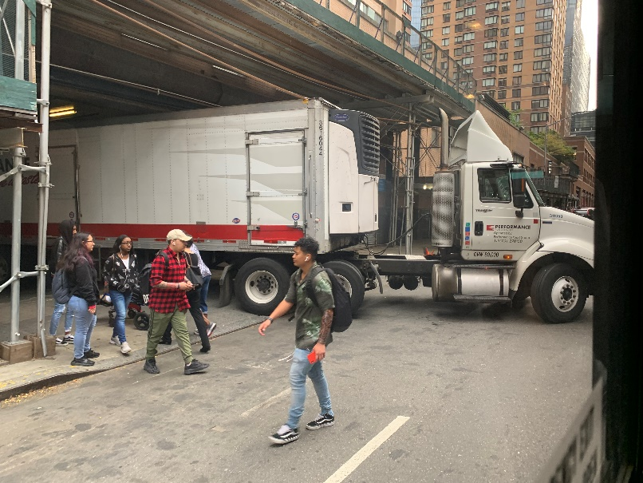
Large Vehicle Turns

Slide 12
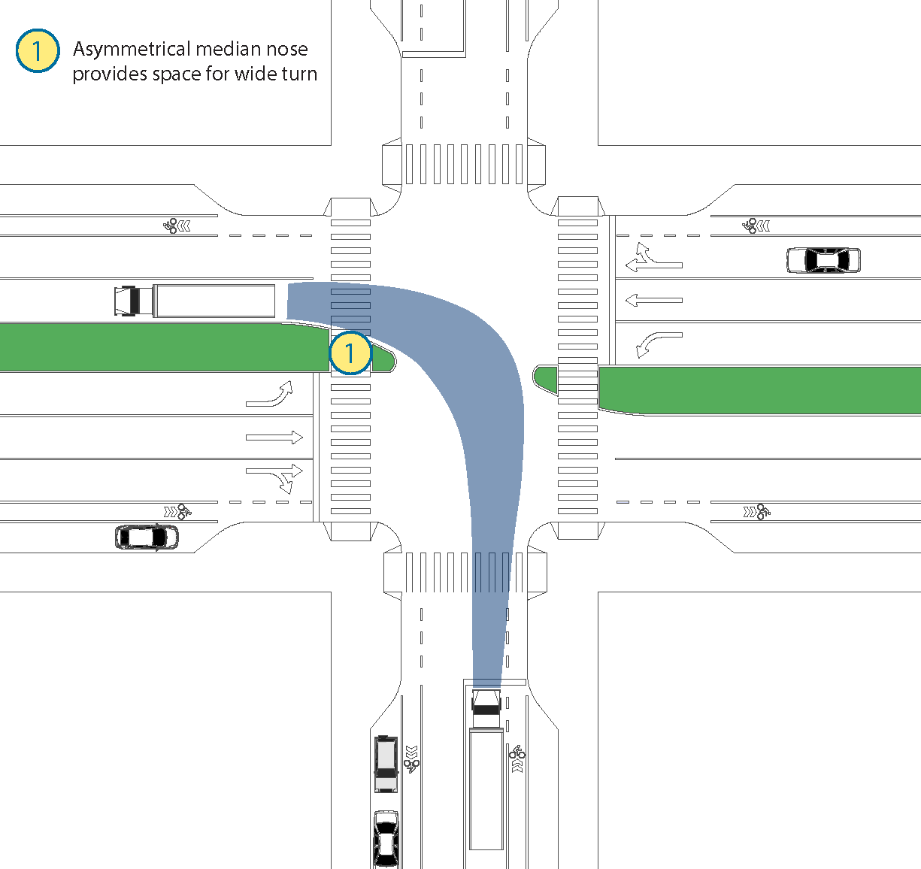
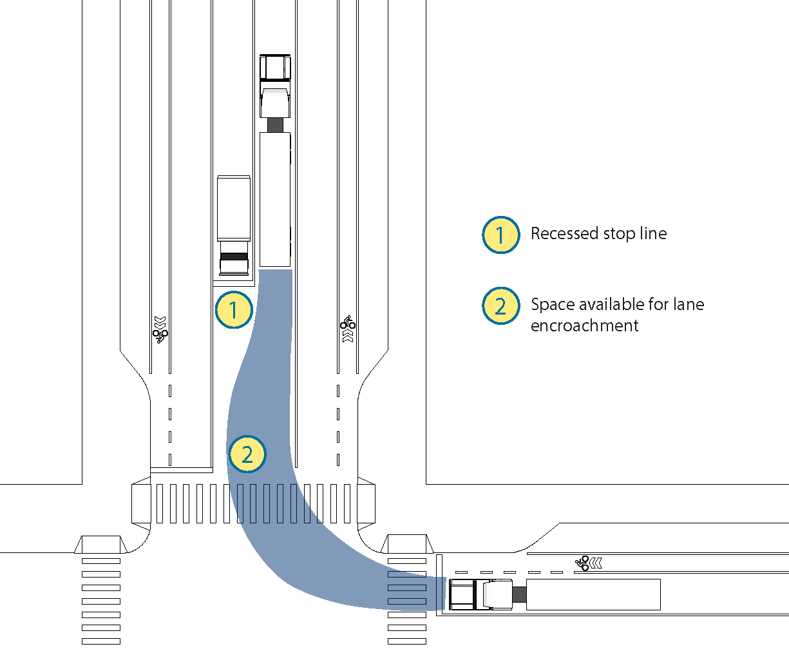
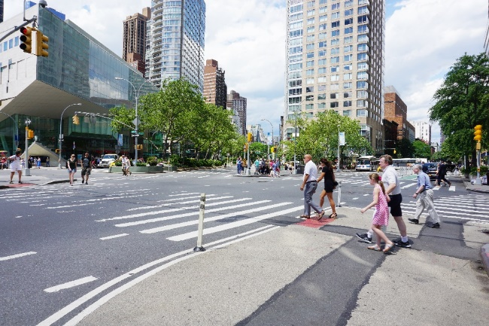
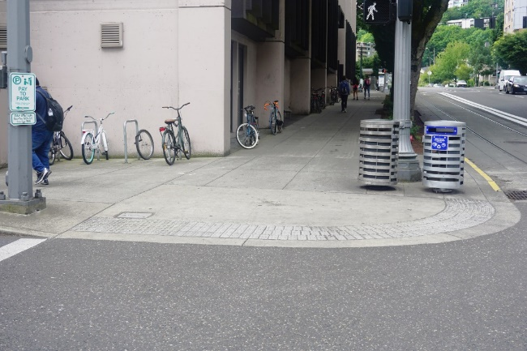
Design Solutions

Slide 13
Regulatory Solution: Vehicle Size Restrictions
Fixed
Time-based
Safety benefits of size restrictions must be carefully weighed against related impacts
VMT and congestion
Operator costs and industry participation

Slide 14
Operational Solution: Dedicated Signal Phases

Slide 15
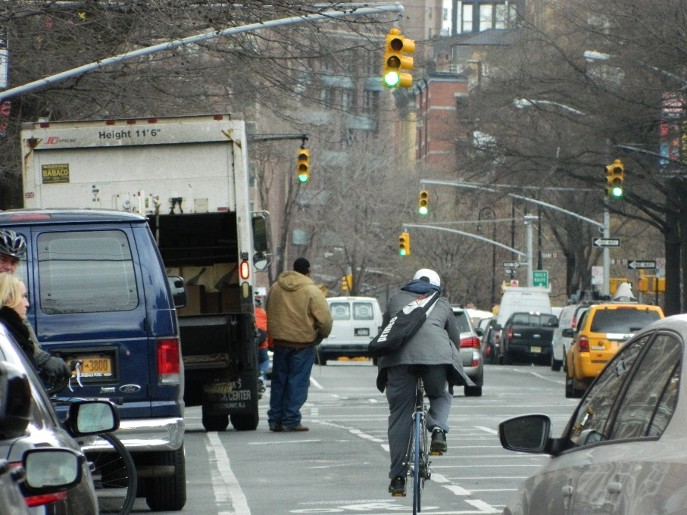
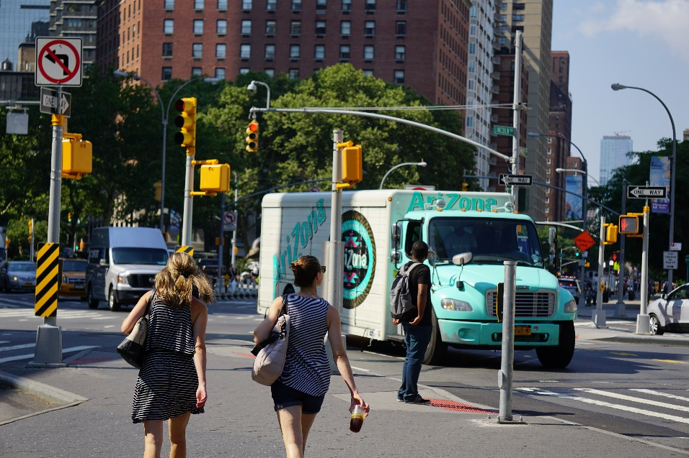
Conflicts with vulnerable road users

Slide 16
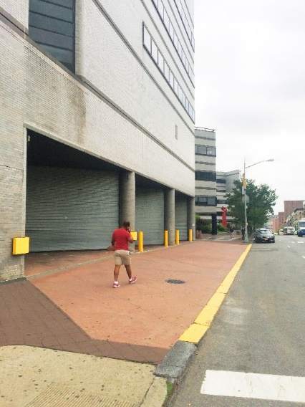
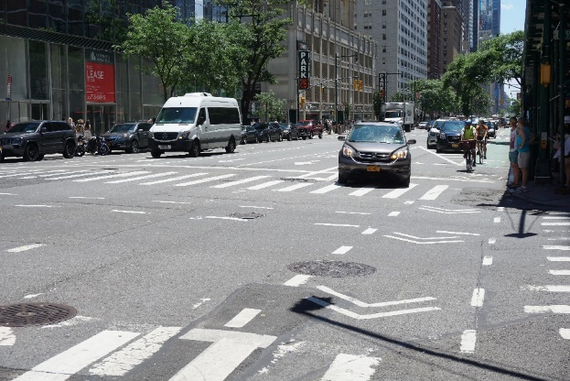
Design Solutions: Bike Infrastructure, Clear Identification of Conflict Zones

Slide 17
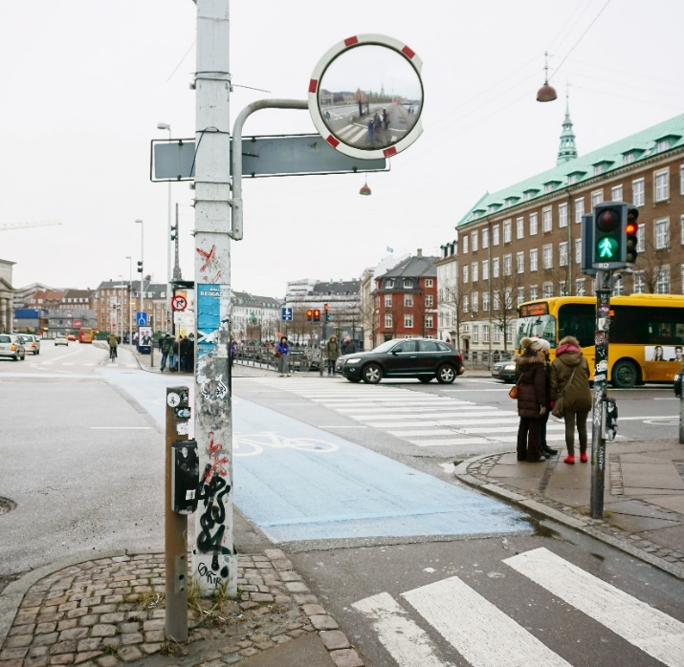
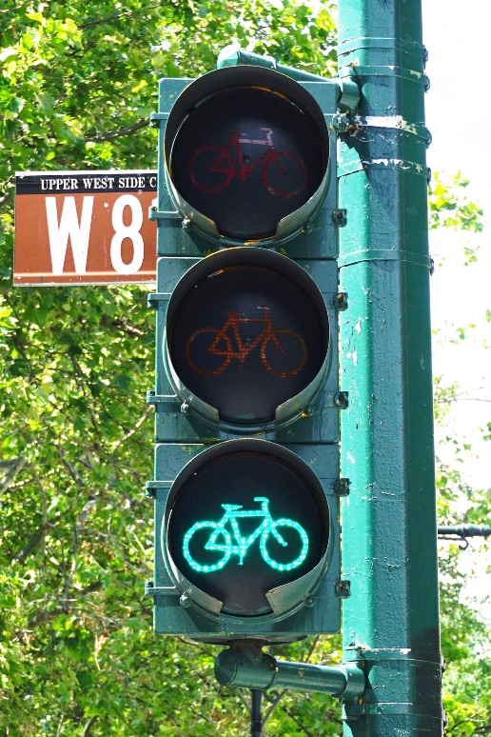
Operational Solutions: Dedicated Signal Phases and Roadside Mirrors

Slide 18
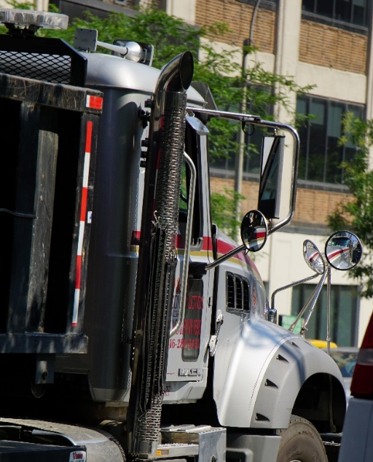
Vehicle-Based Solutions
Mirrors
Fresnel safety lenses
Cameras
Side guards
Direct vision

Slide 19
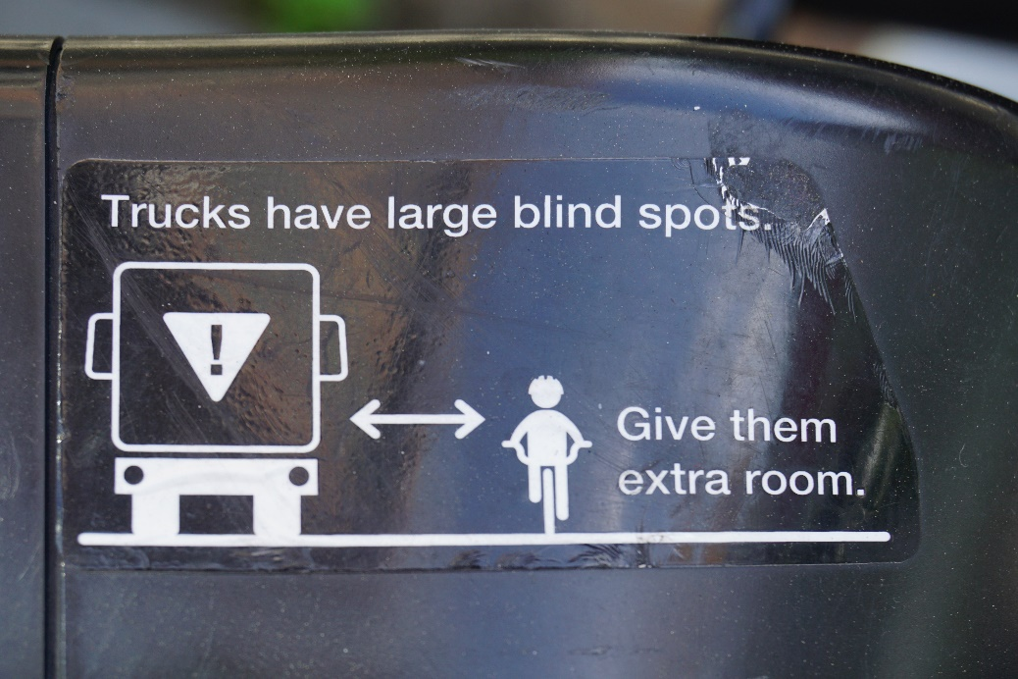
Education
Drivers
Non-motorized travelers
General public

Slide 20
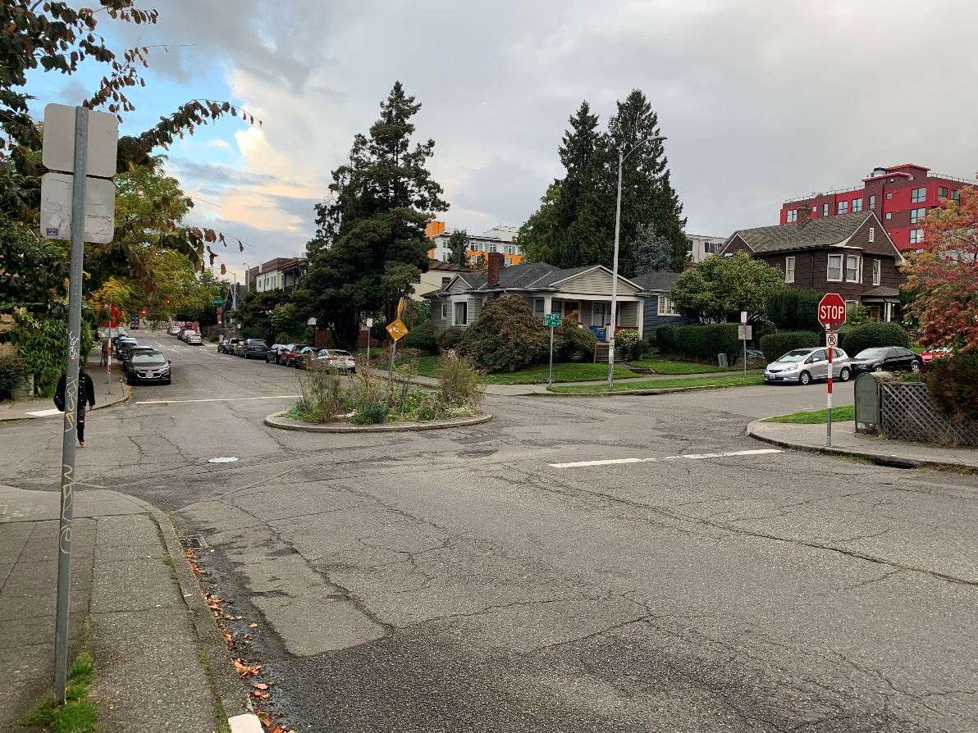
Speed Reducers

Slide 21
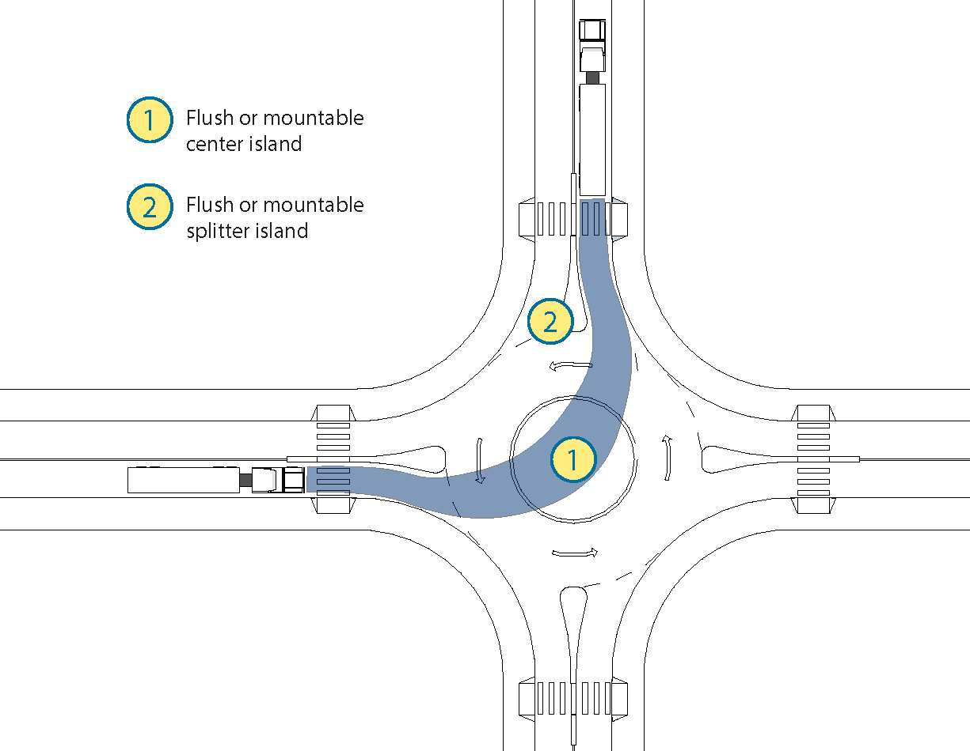
Design Solutions

Slide 22
Network connectivity/ redundancy
Change in street direction
Network gaps
Difficult to navigate street infrastructure

Slide 23
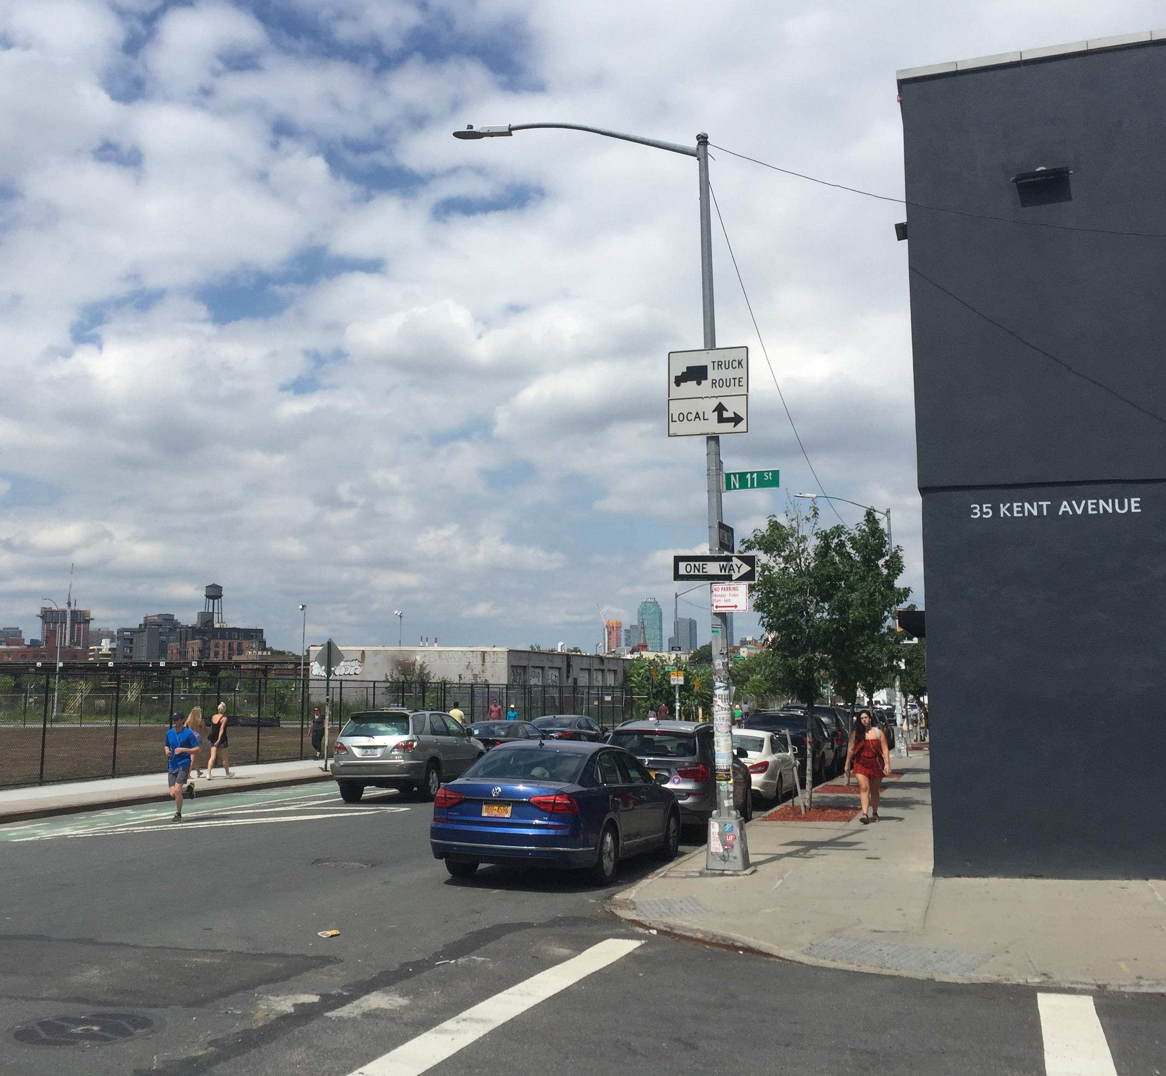
Design Solutions
Short blocks/frequent intersections
Reasonable alternative routes

Slide 24
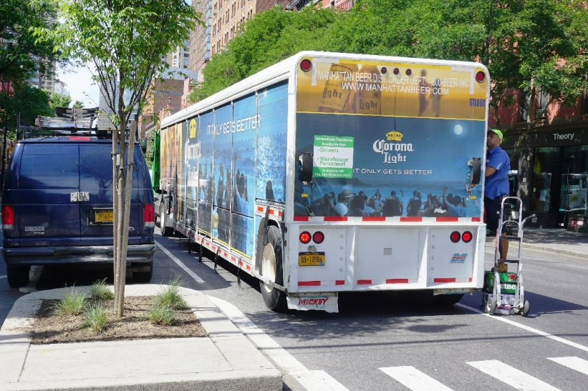
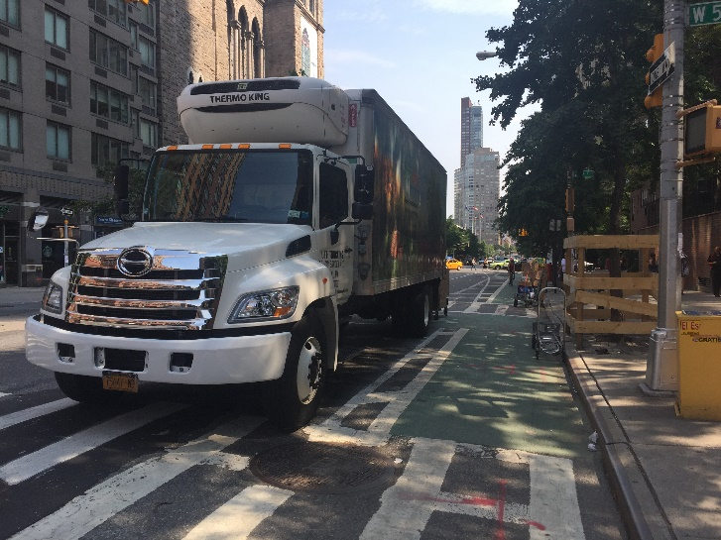
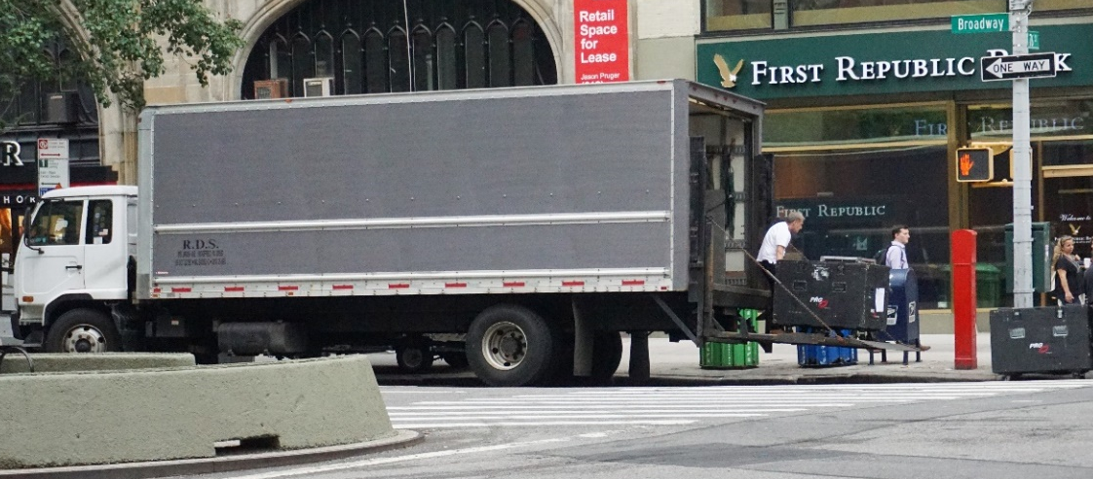
Space for parking, loading, and delivery

Slide 25
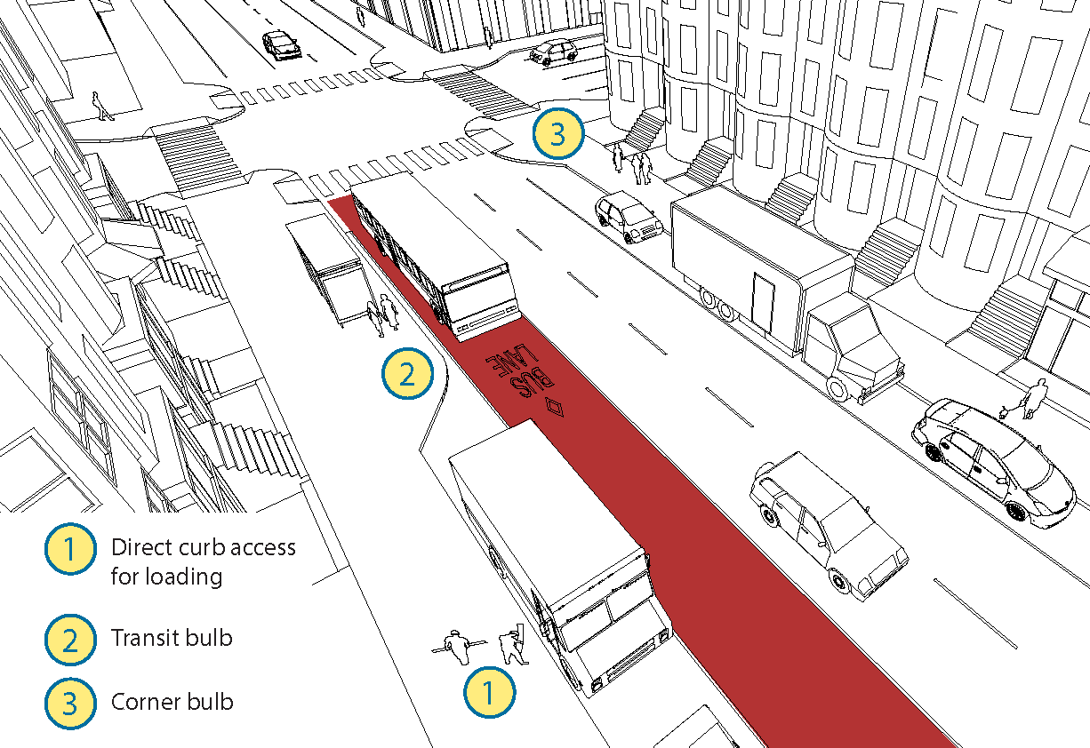
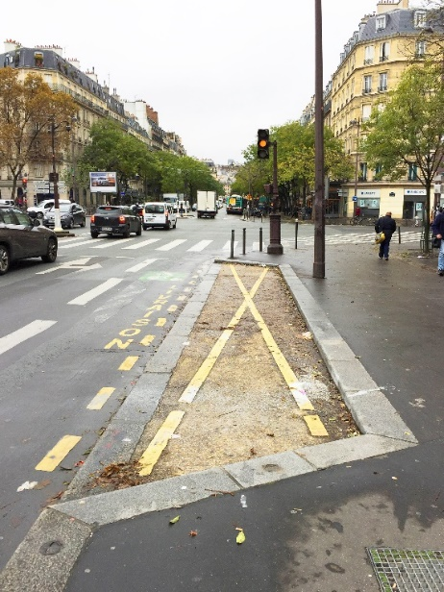
Design Solutions

Slide 26
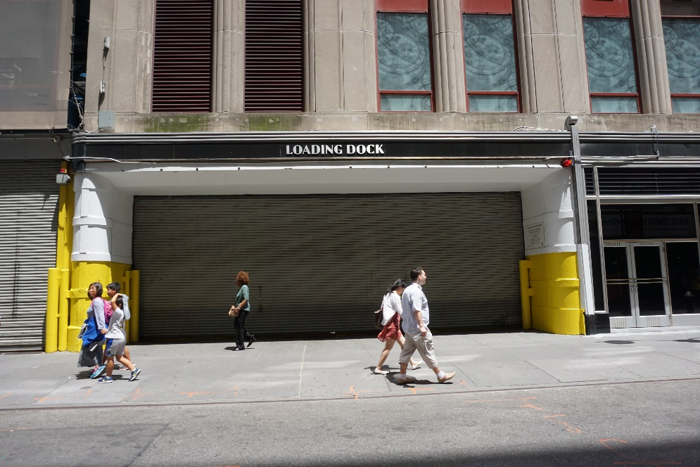
Regulatory Solutions

Slide 27
Operational Solutions
Building Delivery Management
Centralized delivery location
Secure storage room
Lockers
Loading dock appointment system
Enforcement
Commercial vehicles
Loading zone obstructions

Slide 28
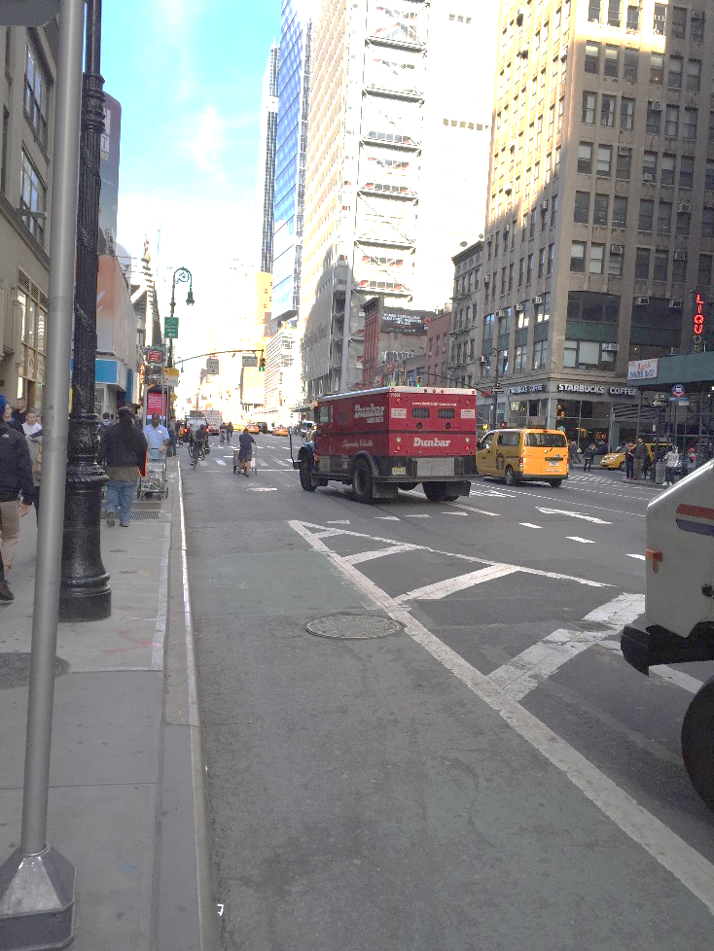
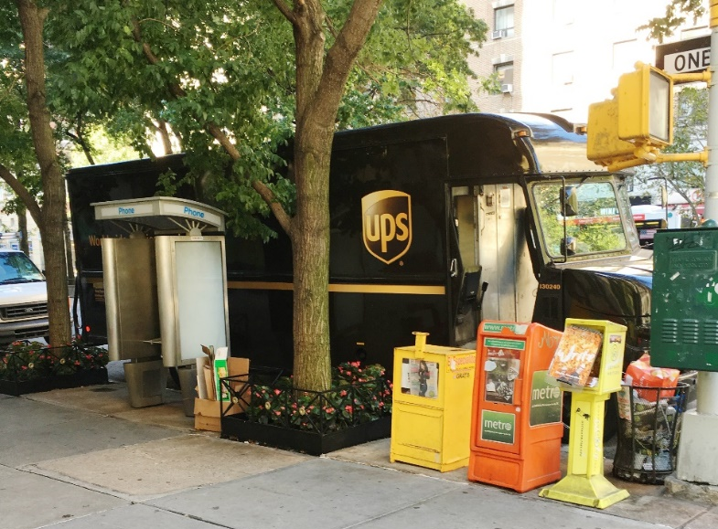
Curb and building access

Slide 29
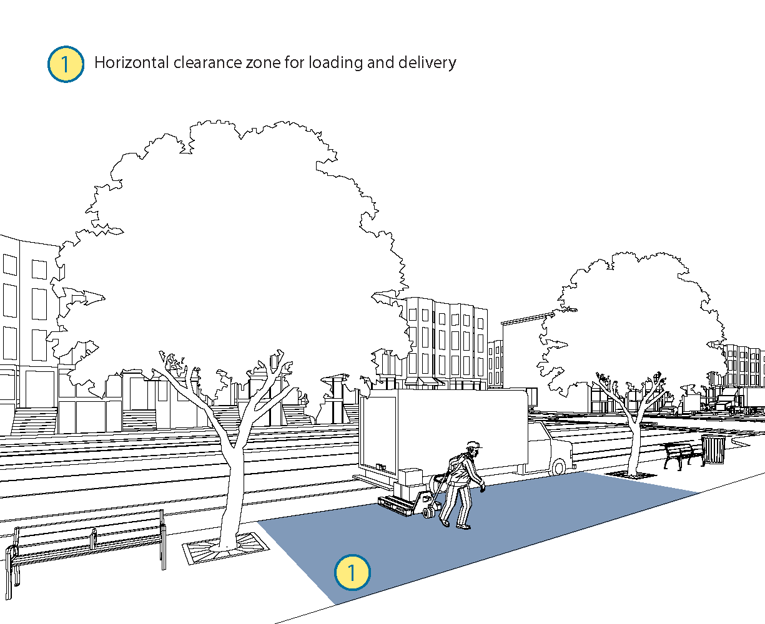
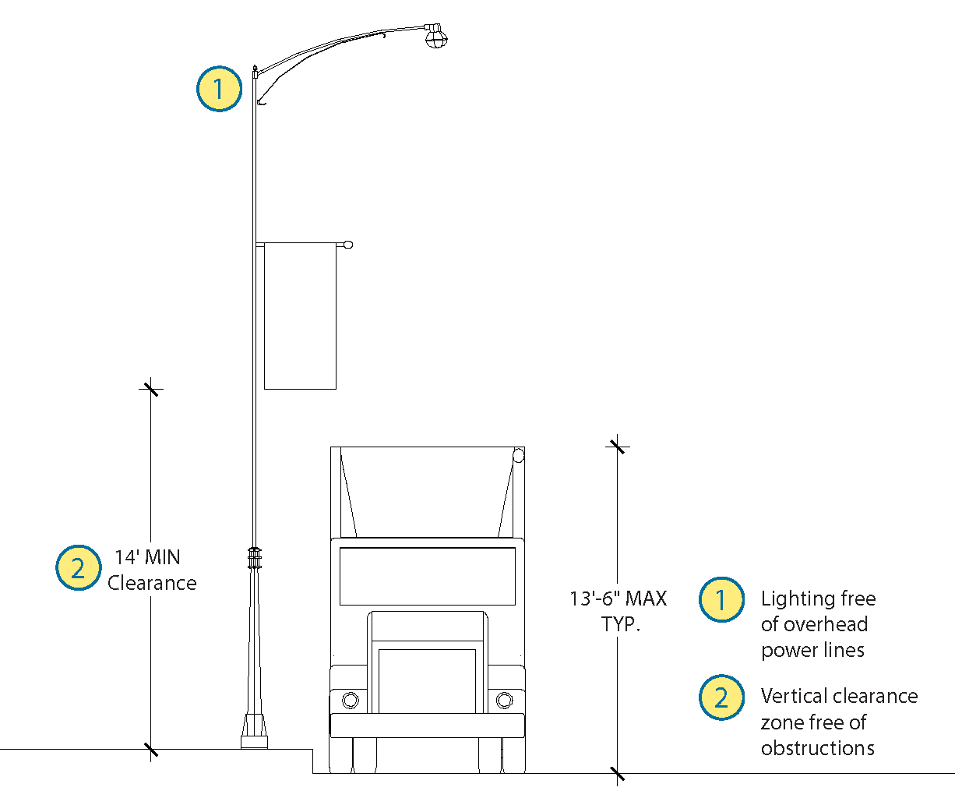
Design Solutions

Slide 30
Change the volume, spatial, or temporal distribution of demands
May require policy change, infrastructure investment, and/or behavior change by multiple stakeholders
Will only be implemented if costs are acceptable to decision-makers
Demand Management

Slide 31
Off-Hour Deliveries
Method | Benefits | Challenges/Concerns
Shift deliveries to non-peak hours Early morning Late evening Overnight | For operator: Reduce travel time delays, fuel costs, and parking fines | For operator: Increase driver labor costs Increase safety risk
 | For business: Receive deliveries when few customers present | For business: Additional staff costs for off-hour receipt
 | For neighborhood: Reduce congestion impacts Reduce demand for shared curb space | For neighborhood Generate delivery noise at night

Slide 32
Consolidation Center
Method | Benefits | Challenges/Concerns
Transfer goods from large freight vehicles to small, green vehicles for final delivery Consolidate goods from multiple carriers onto shared vehicles | For operator: Avoid expensive last mile costs | For operator: Increase costs for transloading Lose final delivery visibility
 | For business: May provide value added services May improve reliability | For business: May have to pay premium for services
 | For neighborhood: Reduce large vehicle trips Reduce demand for parking Reduce emissions | For neighborhood May increase local VMT May require public subsidy for start-up, operations

Slide 33
Lockers and Pickup Points
Method | Benefits | Challenges/Concerns
Lockers: Secure locker where package can be accessed via security code; may be located in residential area, public space, or local business Pick-up Points: Staffed delivery points at local businesses (e.g. pharmacy, grocery store) | For operator: Avoid expensive failed deliveries, repeat trips | For operator: Difficult to identify host business
 | For residents: Provide secure location to leave package | For residents: May be at risk during pickup
 | For neighborhood: Reduce delivery trips | For neighborhood: May need public space
 | For host business: Generate foot traffic | For host business: May use floor space

Slide 34
COVID and Urban Goods Movement
Access to food and medicine
Delivery vs. in-store
Availability
Equity
Prioritization
Commercial vs. residential supply chains
Restaurants
Offices
Schools
Role of shared economy
Role of density??

Slide 35
COVID and Urban Goods Movement
Supply chain resiliency
Supply chain safety
Warehouses
Delivery Personnel

Slide 36
Acknowledgements
NYSERDA
NYC DOT
Volvo Research and Education Foundations
City College
Civil Engineering
Quanquan Chen
Linette Prasad
Architecture
June Williamson
Marija Gjorgjievska
Crystal Xing

Slide 37
Thanks! Questions?
aconway@ccny.cuny.edu
Guidebook can be accessed from:
https://www.metrans.org/news/new-metrofreight-publication-a-guidebook-for-considering-freight-in-complete-street-design-

